Slide 1

ROBUSNESS(24x7 Virtual Doctor) Kushal(1818559) Bhuvan Sharma(1818547) Guide – Er. Anupriya Kaushal
Department of Computer Science & Engineering
IKG PUNJAB TECHNICAL UNIVERSITY MAIN CAMPUS KAPURTHALA

Slide 2
Index
Problem Statement
Process Model
Implementation Technology
Result
Advantages
Conclusion and Future Scope
References

Slide 3
Problem statement
Almost everyone kept on hold while operators connect you to a customer care executive. On an average people spend around 7 minutes until they are assigned to a person. Gone are the frustrating days of waiting in a queue for the next available operative. They are replacing live chat and other forms of slower contact methods such as emails and phone calls. Since chat bots are basically virtual robot they never get tired and continue to obey your command. They will continue to operate every day throughout the year without requiring to take a break. Chat bots can be programmed to respond the same way each time, to respond differently to messages containing certain keywords and even to use machine learning to adapt their responses to fit the situation. A developing number of hospitals, nursing homes, and even private centers, presently utilize online Chat bots for human services on their sites. These bots connect with potential patients visiting the site, helping them discover specialists, booking their appointments, and getting them access to the correct treatment.

Slide 4
Problem statement
An ML model has to be created wherein we could give any text input and on the basis of training data it must analyze the symptoms. A Supervised Logistic Regression machine learning algorithm can be implemented to train the model with data sets containing various diseases CSV files. The goal is to compare outputs of various models and suggest the best model that can be used for symptoms in real world inputs. Data set contains CSV file having symptoms of different diseases compiled together. The logistic regression algorithm in ML allows us to process the data efficiently. The goal here is to model the underlying structure or distribution of the data in order to learn more from the training set.

Slide 5
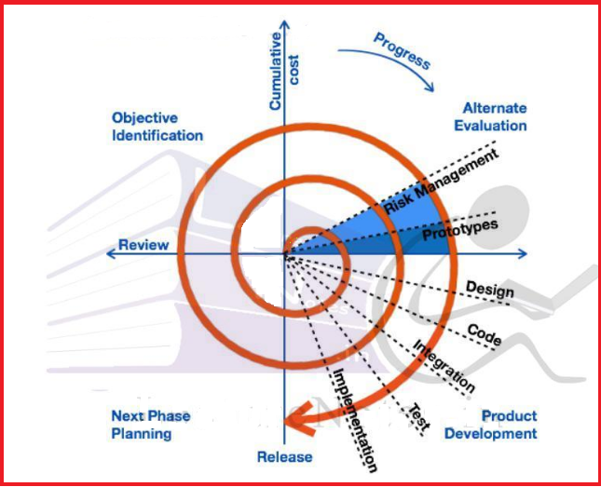
Process Model

Slide 6
Implementation Technology
Hardware Requirement:
RAM: 8 GB
ROM: 1 GB
Monitor with minimum screen resolution of 1024x768.
Software Requirement:
Windows 8 & above.
MacOS 8.0 & above.
Browsers:
Google Chrome, Mozilla Firefox, IE(Internet Explorer),
Microsoft Edge

Slide 7
Dataset Details
The data set is gathered from Kaggle Machine Learning Repository. It is a public arrangement of infections gathered for doctoral exploration. It has three datasets made by numbers out of genuine illness removed from every one of the specialists that are among the top specialists in their feild. In this manner, it will gather those sicknesses and specialists from a dataset as per the side effects classes like weakness, wheezing, cold and others.

Slide 8
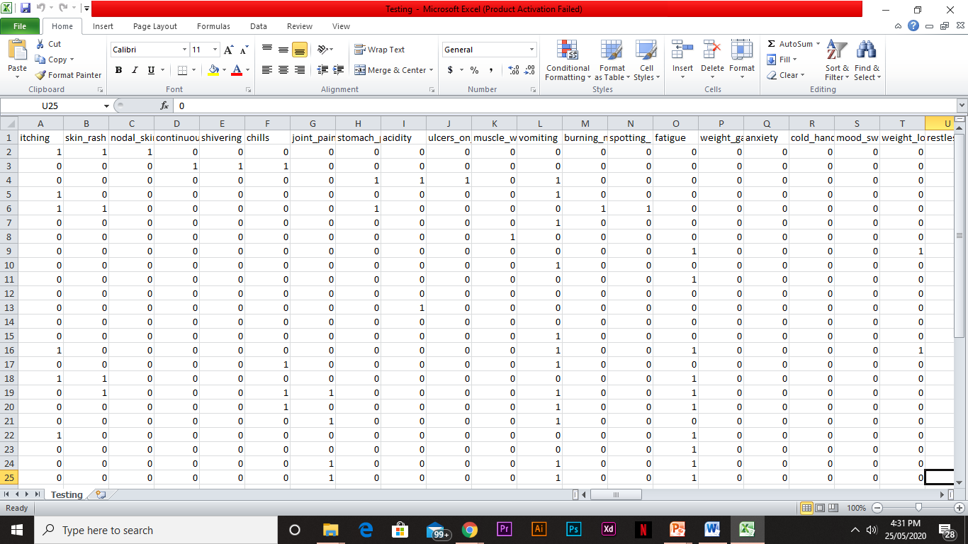
TRAINING DATASET

Slide 9
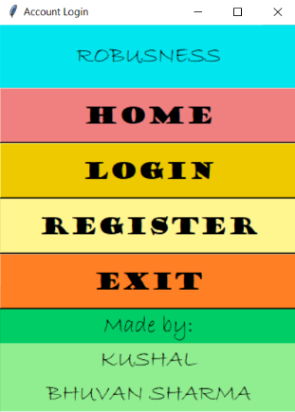
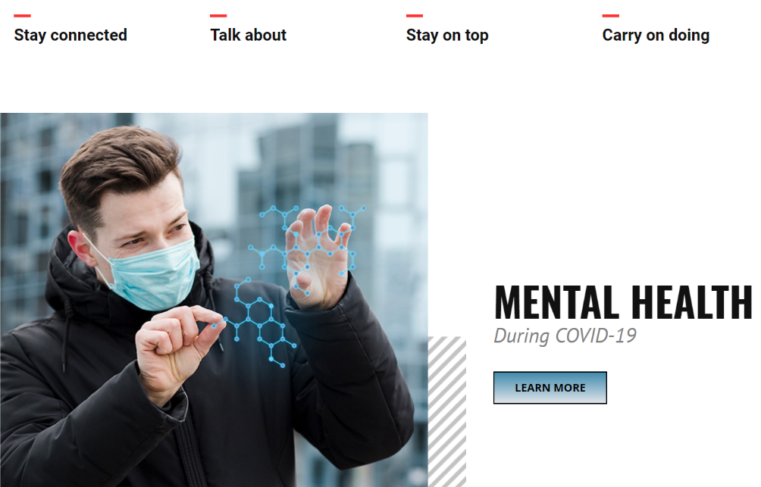
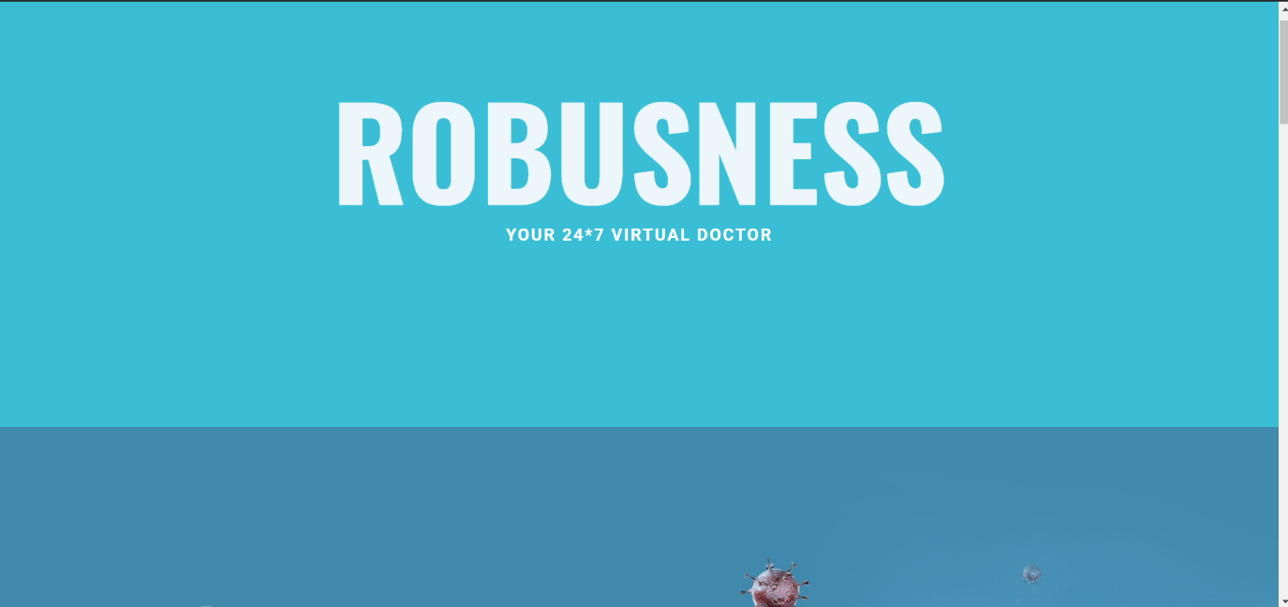
RESULT

Slide 10
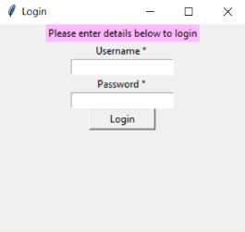
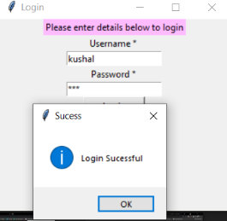
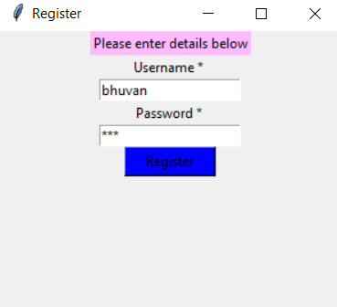
RESULT

Slide 11

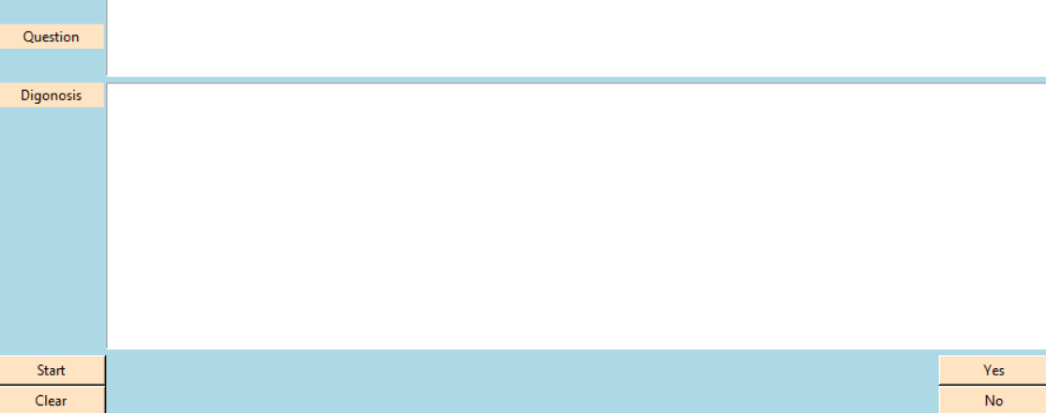
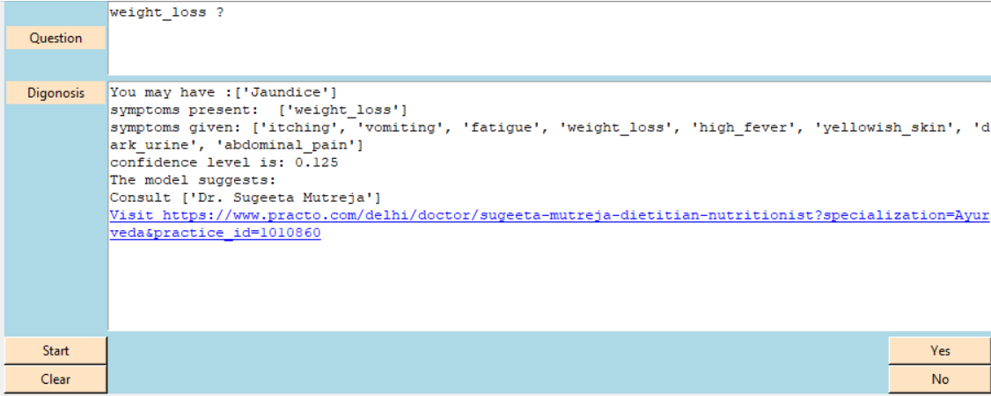
RESULT

Slide 12
Analysis of Result
We can reason that this framework giving the exact outcome. As we are utilizing enormous dataset which will guarantees the better exhibition.
Accordingly we develop a framework which is valuable for individuals or emergency clinics to assist the clients with openly asking clinical questions and worries over text. Framework will get yield for the illness. Client can find related solution showed on programming and allude it for examination

Slide 13
ADVANTAGES
1.Omni-capable
The VIRTUAL DOCTOR converses seamlessly across multiple digital channels and retains data and context for a seamless experience. In best cases, even passing that information to a live agent if needed.
2.Free to Explore
Our app can reach, consume, and process vast amounts of data– both structured and unstructured–to surface insights from any source - to gather relevant data to solve customer issues quickly.
3.Autonomous Reasoning
The app can perform complex reasoning without human intervention. For example, a great Service VIRTUAL DOCTOR should be able to infer solutions based on relevant case histories.

Slide 14
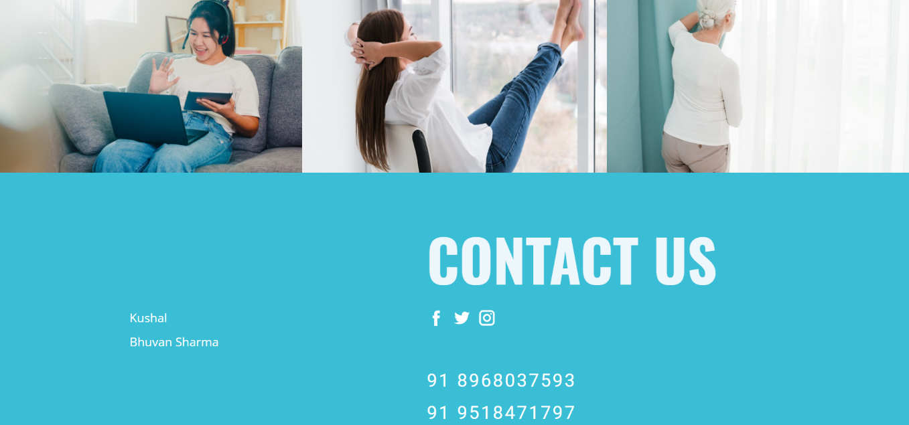
ADVANTAGES
4.Pre-Trained
The app is pre-trained to understand brand-specific or industry-specific knowledge and terms. Even better, it’s pre-configured to resolve common customer requests of a particular industry.
5.Register/Log-in
To access this app and individual needs to register and then use the registration ID to log in to access the features.
6.User Interface
A user friendly interface which is engaging and easy to access.

Slide 15
Conclusion & Future Scope
VIRTUAL DOCTOR is a thing of the future which is yet to uncover its potential. Machine learning has changed the way companies were communicating with their customers. With new platforms to build various types of chat bots being introduced, it is of great excitement to witness the growth of a new domain in technology while surpassing the previous threshold. Thus, we can conclude that this system giving the accurate result. As we are using large dataset which will ensures the better performance. Thus we build up a system which is useful for people to detect the disease by typing symptoms.

Slide 16
REFERENCES
https://en.wikipedia.org/wiki/Chatbot https://en.wikipedia.org/wiki/Disease
https://www.youtube.com/playlist?list=PLQVvvaa0QuDdc2k5dwtDTyT9aCja0on8j
1
https://www.kaggle.com/tags/healthcare (Dataset)
2
3

Slide 17
Thanks!
Any questions?

